Slide 1
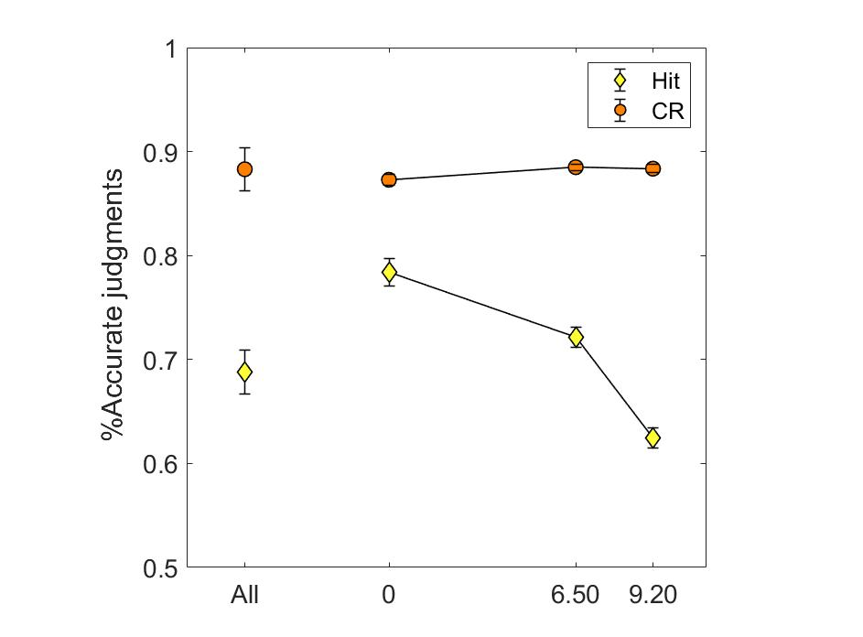

Slide 2
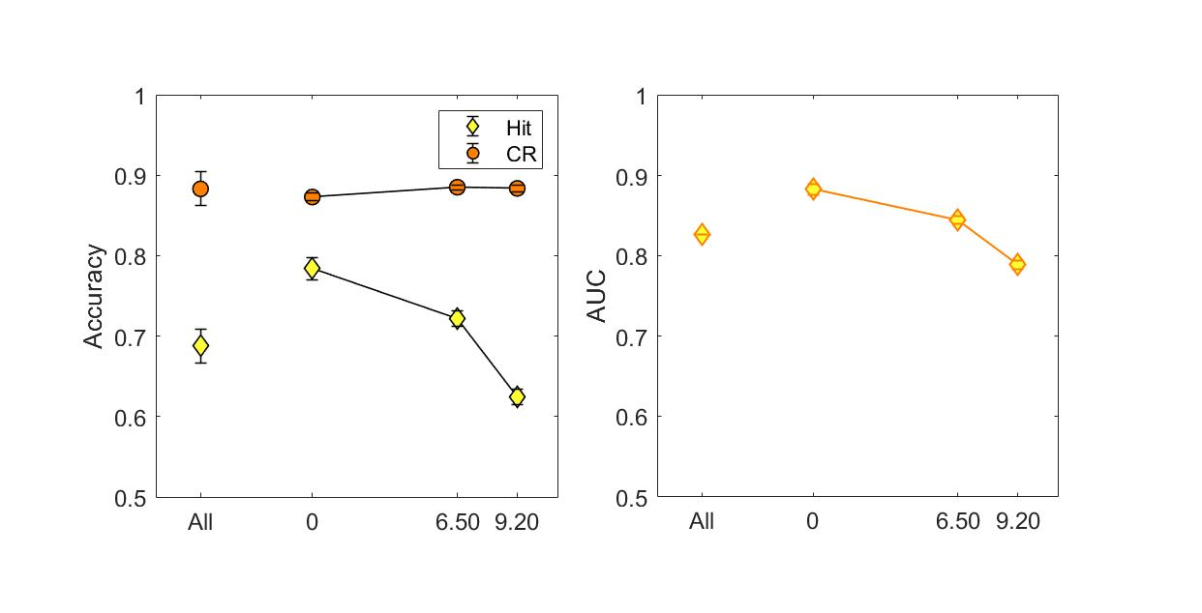

Slide 3
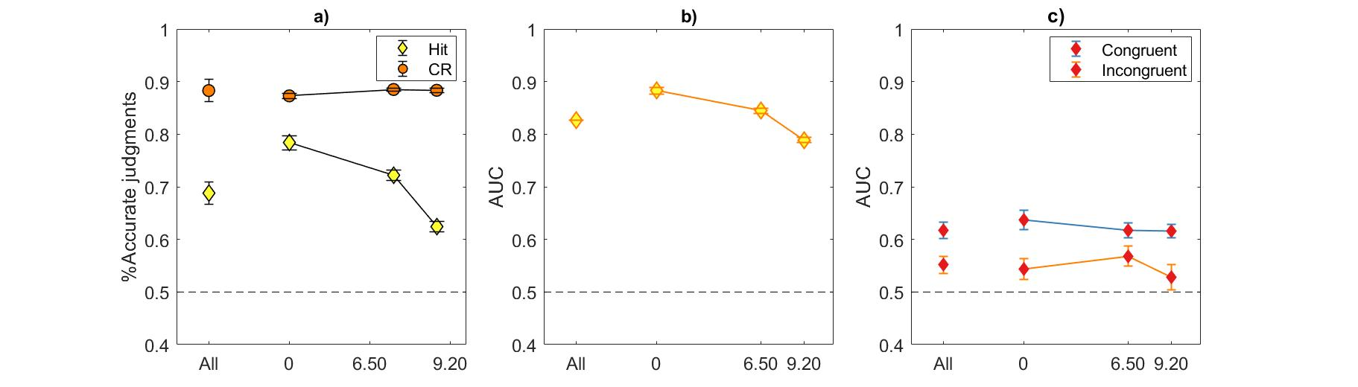

Slide 4
Decision × confidence

Slide 5
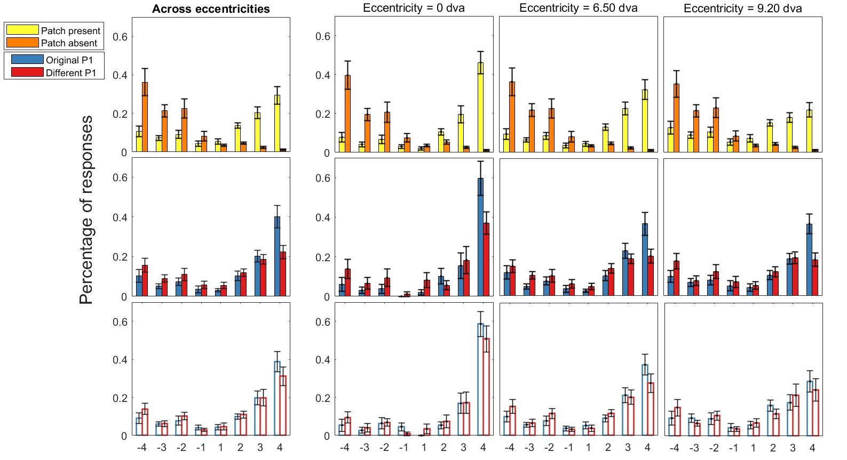
Null patch
Present patch
Congruent original
Congruent different
Incongruent original
Incongruent different
Decision × confidence

Slide 6
Decision × confidence

Slide 7
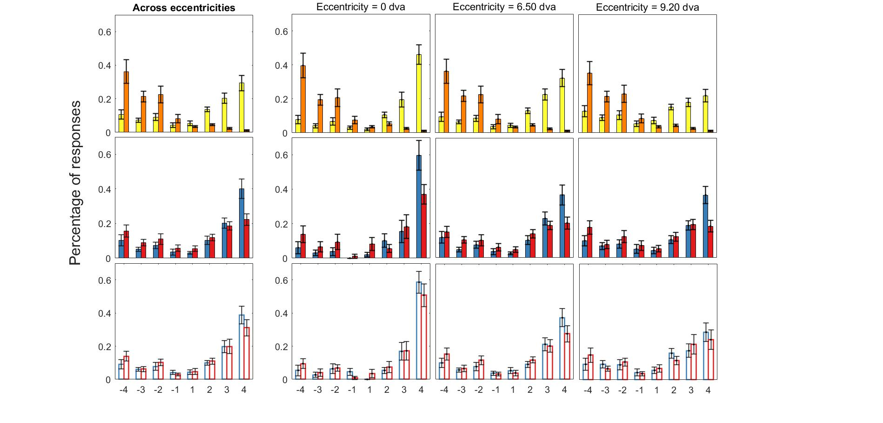



Decision × confidence

